Slide 1
ATO Project
Data Science Workshop
Summer Semester 2023
Project manager: PhD Marcin Luckner
Amir Ali​
Jacek Czupyt​
Patryk Wrona​
Stanisław Matuszewski​

Slide 2
Agenda
Introduction
Solution Architecture
Methodology
Results
Conclusions

Slide 3
Introduction
Solution Architecture
Methodology
Results
Conclusions

Slide 4

Introduction
Data Security Threats:
Imposter
Hacker
Many more on daily basis ~ over a million per year

Slide 5


Introduction
Proposed solution for impostor detection via ATO - Account Takeover project
Analysis:
Which features are useful for impostor detection purposes
related with mouse or keyboard?
Evaluation:
Chosen impostor detection systems.

Slide 6

Data Collection
Data source: https://github.com/mluckner/ATO-data - the data collected within another project.
- aggregated(~ each 10 s) mouse and keyboard events, from 198 different users
- user identifiers available
- no impostor labels
- missing values
46 mouse-related features,
61 keyboard-related features,
3 mouse & keyboard (both) - related features
rows | columns
21 804 | 110 ( + user identifier)

Slide 7
Introduction
Solution Architecture
Methodology
Results
Conclusions

Slide 8
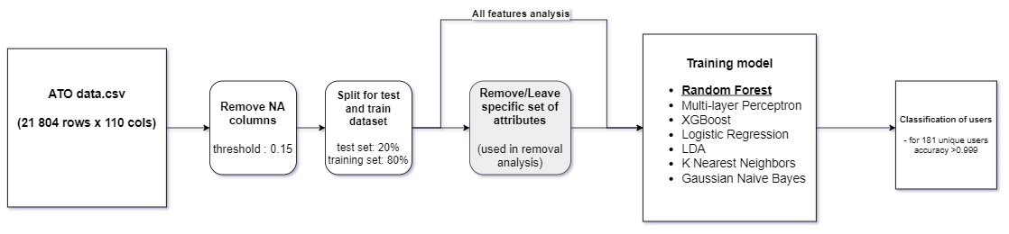
Solution Architecture
→ impostor detection system

Slide 9
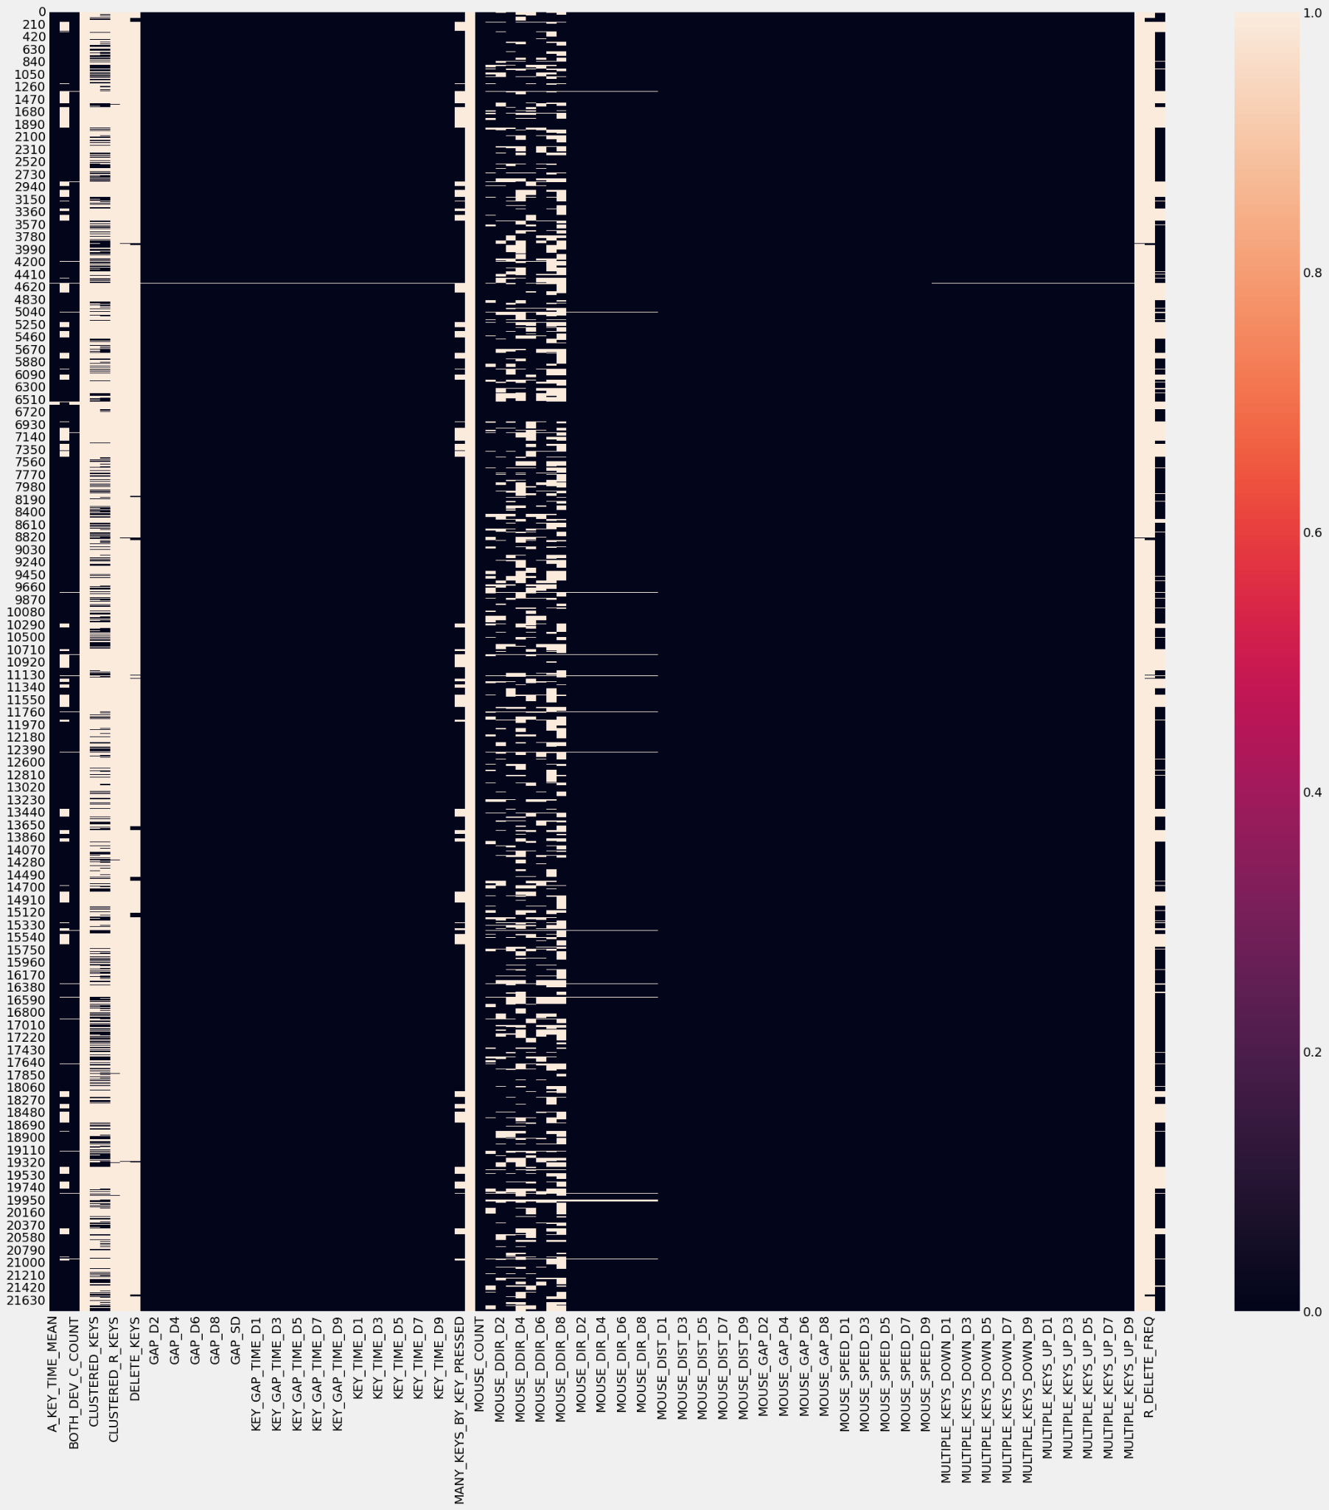
Handling Missing Values
Remove Records Approach

Slide 10
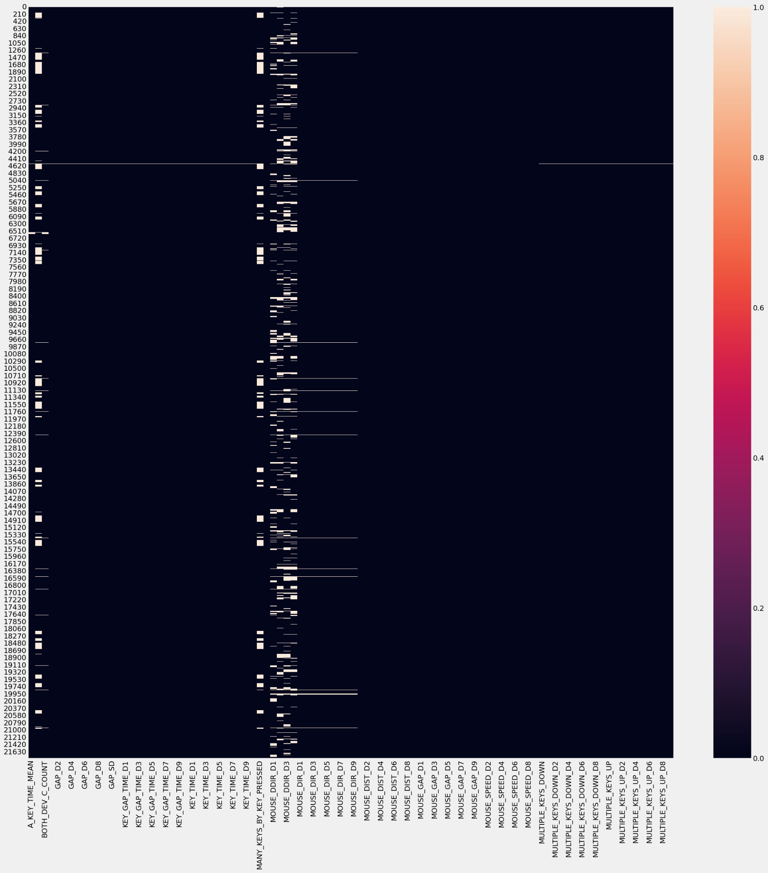

Handling Missing Values(Cont’s)
Remove Column - 20% Missing values
14 Features
Remove Rows
Simply drop the missing value
10455 Records

Slide 11
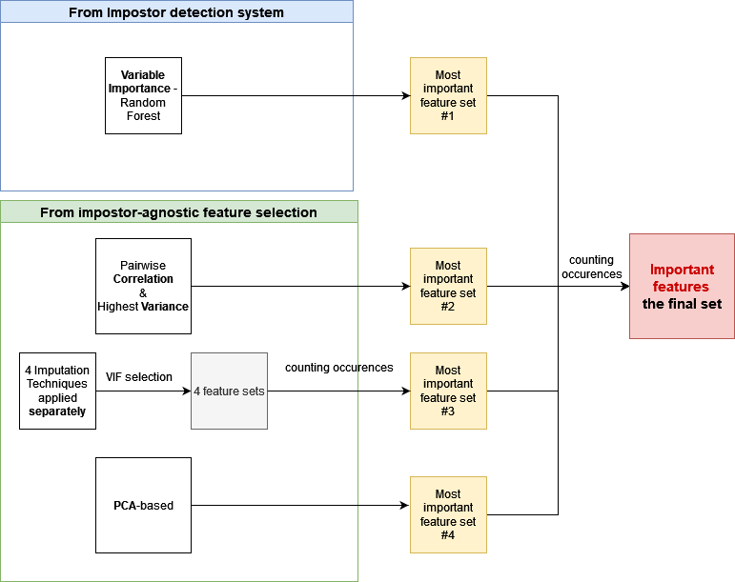
Solution Architecture
→ impostor detection system
→ feature selection
→ showing the pipeline i.e. 198-label classification, train-test split

Slide 12
Introduction
Solution Architecture
Methodology
Implementation
Results
Conclusions

Slide 13
Handling Missing Values
1) Remove Column - at least 20% Missing values
14 Features with the most missing values:
2) Remove Row - if any value is missing within this row
10455 observations removed
BOTH_DEV_M_COUNT | CLUSTERED_KEYS | CLUSTERED_NR_KEYS | CLUSTERED_R_KEYS | DELETE_KEY | DELETE_KEYS | MOUSE_CLICK_RATIO
MOUSE_DDIR_D4 | MOUSE_DDIR_D5 | MOUSE_DDIR_D7 | MOUSE_DDIR_D8 | R_DELETE | R_DELETE_FREQ | S_KEY_TIME_MEAN

Slide 14
Methodology - feature selection ( Imputation-based methods)
In order to impute missing values, we used 4 imputation methods:
Removing rows with missing values
Most frequent value imputation
kNN imputation
miceForest ( python mice library)
After applying each technique, we iteratively selected 30 features using VIF.
→ 4 different sets of 30 features
The final step was counting the occurrences of each feature.
→ The final set of features = features occurring in all 4 sets ( having count = 4)

Slide 15
Methodology - feature selection ( standard methods)
The used methodology was based on 2 standard approaches:
Removing the variables having the lowest variance
Selecting uncorrelated variables, based on pairwise correlation

Slide 16
Feature Selection
Correlation Approach
Correlation is a statistical measure that quantifies the strength and direction of the linear relationship between two variables. It ranges from -1 to 1.
Correlation used as a feature selection approach to identify variables that have a strong relationship with the target variable or with each other
Low Variance Approach
The low variance method is a feature selection technique that focuses on identifying variables with minimal variation or near-zero variance across the dataset.
Variables with low variance may not contain sufficient information for predictive modeling or may not contribute significantly to the analysis.

Slide 17
Feature Selection - Pairwise Correlation
Variables with a correlation coefficient above 70% identified as highly correlated and marked for removal.
Features Before Applying Feature Selection - 96
Features which have high pairwise correlation - 63
Features Selection - 33

Slide 18
Feature Selection - Low Variance
Features with a variance below 25% of the maximum possible variance removed.
Features Before Applying Feature Selection - 96
Features which have low variance - 45
Features Selection - 51

Slide 19
Methodology - Feature Selection - PCA
1. Standardize the data: Scale the features to have zero mean and unit variance using StandardScaler to ensure consistency in feature magnitudes.
2. Perform PCA: Use PCA to calculate the principal components that capture the maximum variation in the data. Set the desired number of components to 30.
3. Feature transformation: Apply fit_transform on the PCA object to transform the original features into the reduced dimensional space defined by the principal components.
4. Evaluate feature contributions: Assess the component_loadings attribute to determine the importance of each original feature in the principal components. Higher absolute values indicate stronger contributions.
5. Select important features: Iterate over the component_loadings to identify the feature with the highest absolute value for each principal component. These features are considered the most influential.
6. Saving the important features: Print the names of the selected features that contribute the most to the principal components.

Slide 20
Methodology - Feature Selection - PCA
1. Standardize the data
2. Perform PCA
3. Feature transformation
4. Evaluate feature contributions
5. Select important features
6. Saving the important features:

Slide 21
Methodology - data preprocessing
Before applying any impostor detection system or feature selection technique:
The 2 least occurring users were removed (having only few observations).
Besides, features having at least 20% missing values, were removed.
Columns having 0 variance were also removed.

Slide 22
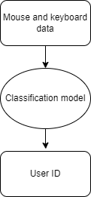
Methodology - impostor detection system ( classification)
The objective of the impostor detection system is to distinguish the real user of an account from an impostor. We utilize the simple approach of training models that can classify users based on the provided mouse and keyboard data.
Some of the models provide methods of extracting feature importance, allowing us to use them for feature selection.

Slide 23
Methodology - impostor detection system ( classification)
The simple approach of training models that can discern each user based on the provided mouse and keyboard data. It is 198 label classification.
Used classification methods:
KNeighbors | GaussianNB | BernoulliNB | ComplementNB | MultinomialNB
RandomForest | LogisticRegression | LDA | MLP | GradientBoosting

Slide 24
Methodology - feature selection from classification
The objective of the impostor detection system is to distinguish the real user of an account from an impostor. We utilize the simple approach of training models that can classify users based on the provided mouse and keyboard data.

Slide 25
Methodology - impostor detection system ( feature removal)
After training a model on whole set of attributes, we conducted a feature removal analysis - we examined what effect rejecting the next most significant features had on the accuracy obtained by the model.
In each case, two scenarios were allowed:
accuracy will significantly decrease
accuracy will remain constant - the rejected feature will be replaced by another equivalent one

Slide 26
Introduction
Solution Architecture
Methodology
Results
Conclusions

Slide 27
Results - impostor detection systems
Despite the relatively large number of classes (198 users), this approach has proven to be surprisingly effective, with Random Forest in particular obtaining over 99.8% accuracy on test data.
The trained models can also be used for the purposes of feature selection.

Slide 28
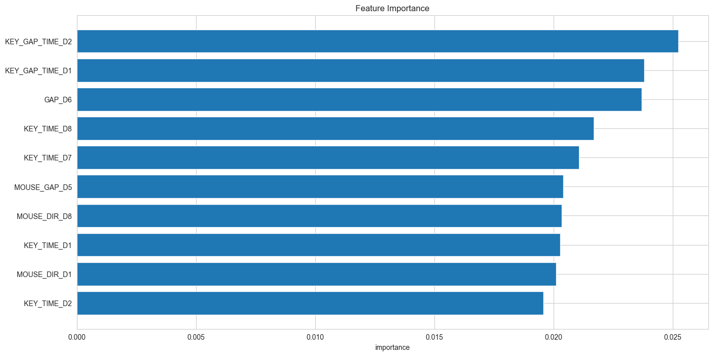
Results - feature selection from model

Slide 29
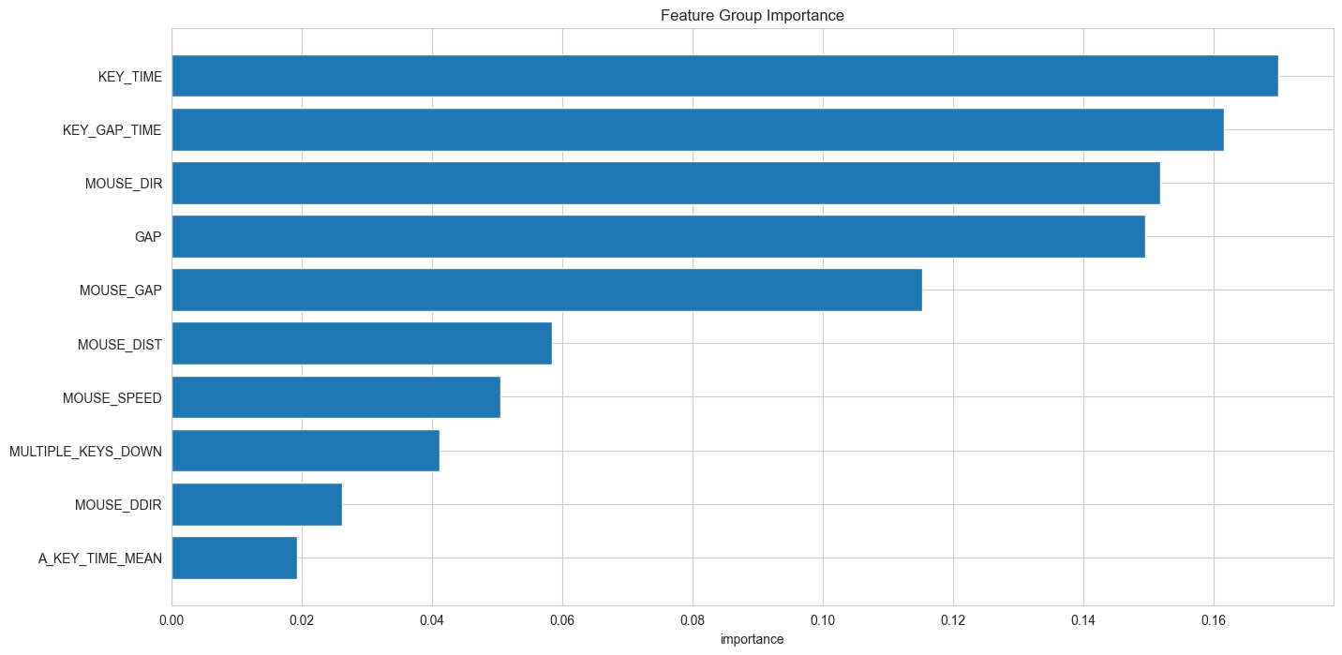
Results - feature selection from model

Slide 30
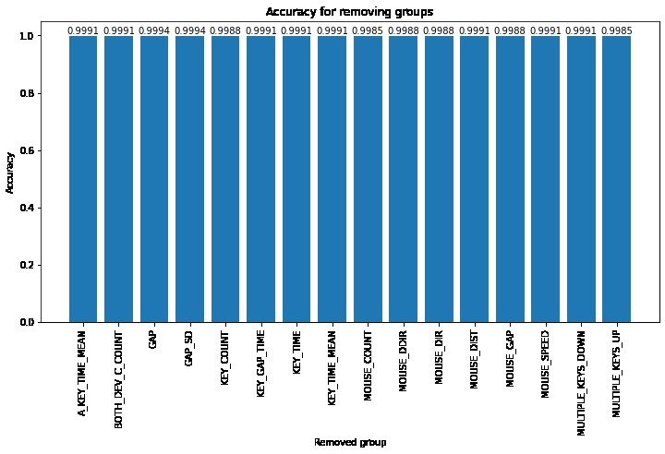

Slide 31
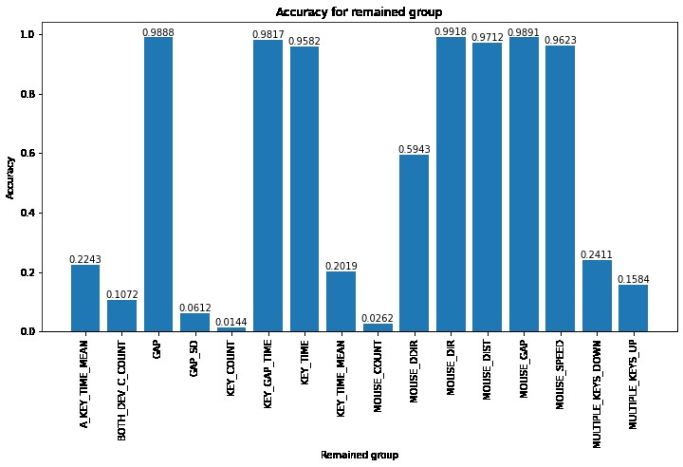
Results - feature selection from model

Slide 32
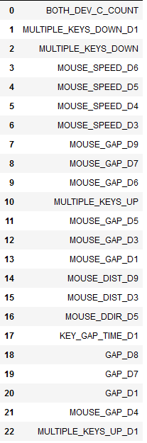
Results - the most relevant feature set
From the set (on the left), one could deduce that mouse features revealed to be the most crucial. Mouse movement gaps and speed were strongly relevant.

Slide 33
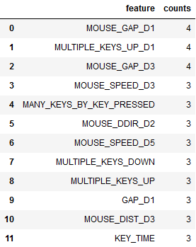
Results - the most relevant feature set
From the set (on the left), one could deduce that mouse features revealed to be the most crucial - they occurred within 3 or all 4 standard FS methods.
Mouse movement gaps and speed were strongly relevant.

Slide 34
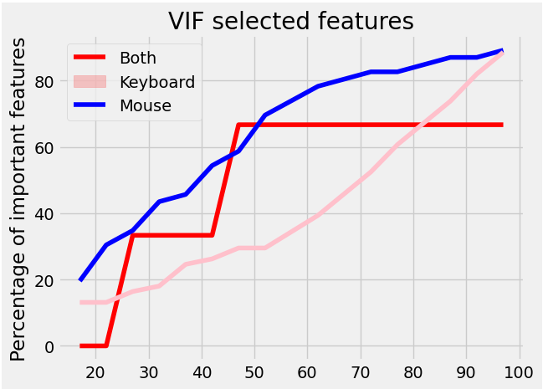
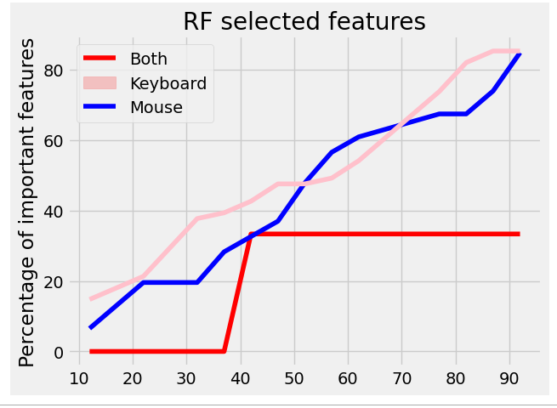
Keyboard or mouse features - which are more relevant?
Percentage of left features in function of feature set’s size.

Slide 35
Introduction
Solution Architecture
Methodology
Results
Conclusions

Slide 36
Conclusions
Random Forest discerns between the users most successfully with accuracy of over 99,8%
Similarly high results can be obtained with use of 10 most significant features
Model requires to be retrained every time the set of users (with at least 10 records) has changed
The least important features were among the keyboard features. The mouse features revealed to be more important than keyboard features.

Slide 37
Thank you for your attention!

